Slide 1

Classifying Craigslist Ads to Improve User Experience
Group - 2
Client Name :
MGMT 59000: Analyzing Unstructured Data
12/06/2023
Notes:
Group -6
Durga Madhab Dash
Madhumathi Ponnusamy
Mourya Gupta Vakacharla
Ritik Khandelwal
Saurav Shakti Borah
Venkata Sai Teja Gangumalla

Slide 2







Group -2 Members
Madhumathi Ponnusamy
Mourya Gupta Vakacharla
Ritik Khandelwal
Durga Madhab Dash
Saurav Shakti Borah
Venkata Sai Teja Gangumalla

Slide 3
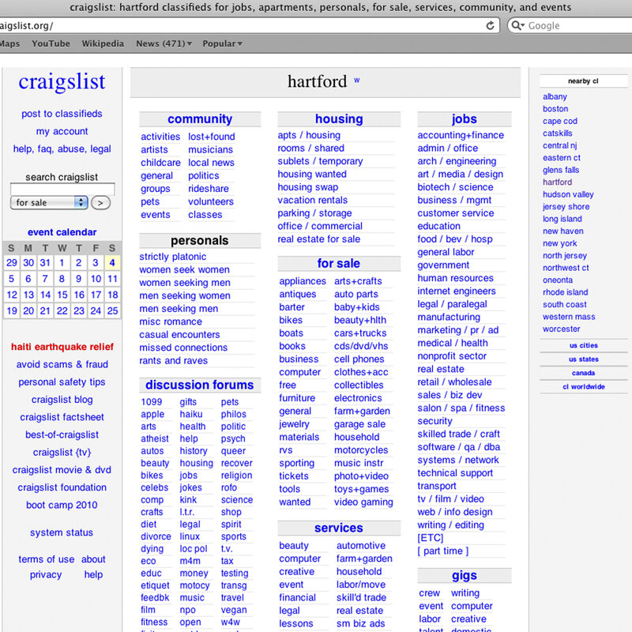

Background
Who?
American Classified advertisements website
What ?
Originated as community message board, now facilitates classifieds/commerce across 700+ cities
Connects local peer-to-peer buyers and sellers for jobs, housing, goods, services, etc.
Our Interest:
We aim to improve the classification under the computer section.
Notes:
Who?
It’s a incorporated as a for-profit in 1999.Started on 1995 by Craig Newmark.Started as email distribution list to friends by the CEO /Founder
More than 30 billion page views per month
More than 50 million in the US alone.
More than 700 local sites in 70 countries
What is the issue?
craigslist users post more than 50 million new classified ads each month
Category of ads is not placed in prefect way makes it difficult for both customers and Mangerial personnels.

Slide 4
Problem Statement
Misclassified Listing
Consumer View
Craiglist View
Misclassified listing under the Computer section leads to a degraded user experience and we plan to solve it.
Customers can’t easily navigate the product under a particular section.
Makes tracking product item difficult for a new consumer
Need: Recategorization of the items under the sub-section
Incur high cost to platform manager to maintain and organize the website.
Negative Consumer Feedback
Lesser Revenue
MGMT 59000: Analyzing Unstructured Data
Notes:
Background - Craigslist's Computers Subsection
Massive online marketplace facilitating peer transactions
Spans laptops, desktops, components, storage, networking, printers
Taxonomy has thousands of self-selected terminal branches
Prone to misclassifications due to:
Consumer ignorance
Community reporting lacking oversight
Prior studies found >40% inaccurate classification:https://www.wired.com/2009/08/ff-craigslist/

Slide 5
Methodology
Data Collection
Data Processing
Modeling
Exploratory Analysis
Logistic Regression
Naïve Bayes
XGBoost
Neural Network
Decision Tree
Random Forest
Light GBM
CatBoost
Web scraping
Keyword Extraction
39.9% listings incorrectly classified as computers
Data Cleaning and handling of null values
Tokenization
Extracted product URL, headers, and text descriptions for 2100 records
Lemmatization
Stopword Removal
Computers
Manual labeling
Term- Vectorization
NOT Computers
Train Test Split (70% Train and 30% test)
MGMT 59000: Analyzing Unstructured Data

Slide 6
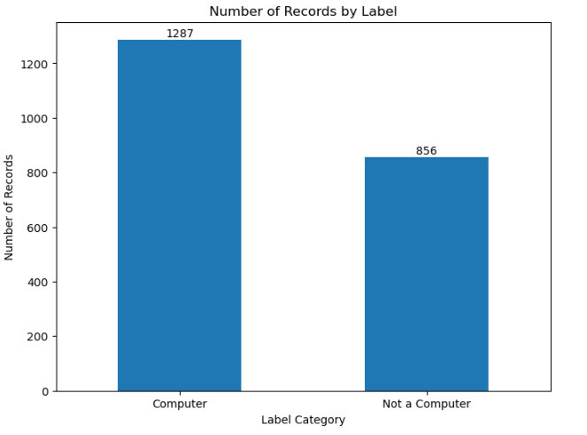
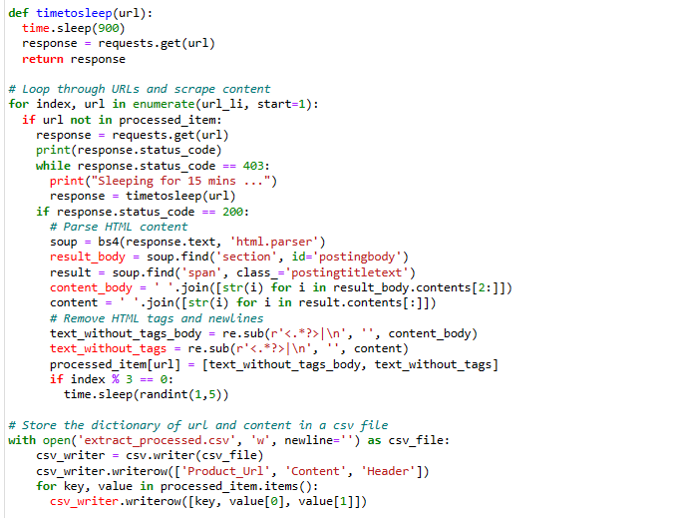
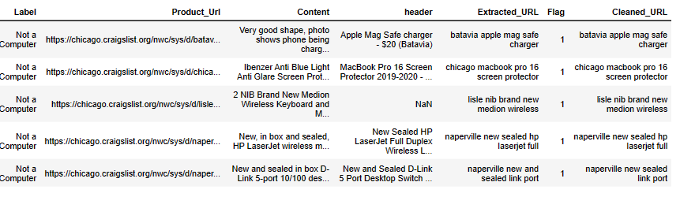
Data Extraction and Labelling
MGMT 59000: Analyzing Unstructured Data

Slide 7
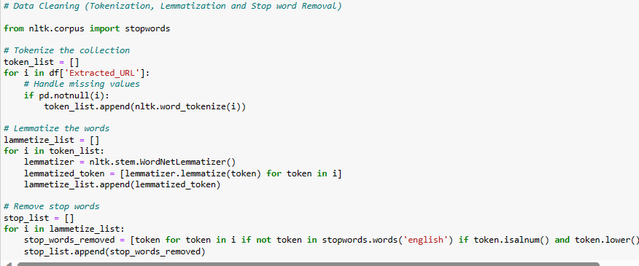
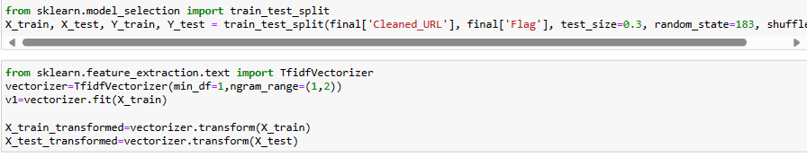
Data Pre-processing and Model Size
MGMT 59000: Analyzing Unstructured Data

Slide 8
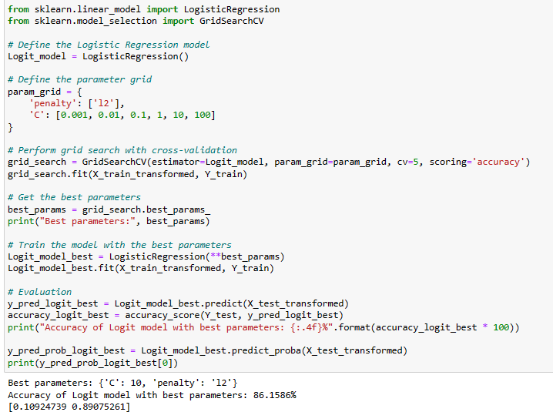
Logistic Regression Model
Considered L2 regularization (Ridge)
prevents overfitting by penalizing large coefficients
works well when many of the features contribute to the target variable
Performed GridSearchCV method
finds the best performed predefined parameters in the model
Results:
Achieved 86.15% accuracy
MGMT 59000: Analyzing Unstructured Data

Slide 9
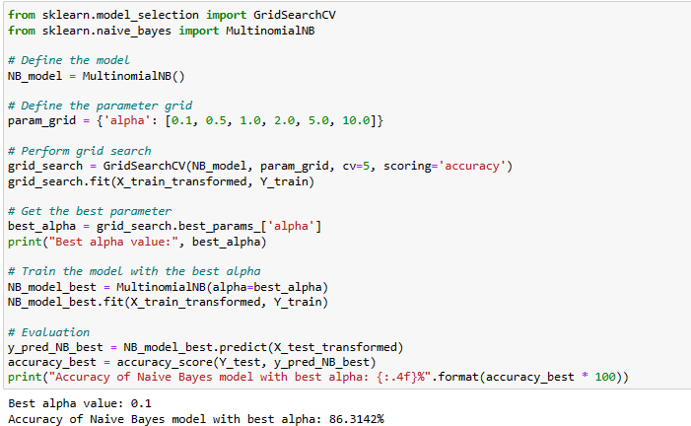
Multinomial Naive Bayes Model
Probabilistic Classification model based on Bayes theorem
effective particularly in NLP tasks like text classification
Dealing with the sparse data
applied Laplace smoothing
Results:
Best alpha value: 0.1
Accuracy: 86.31%
MGMT 59000: Analyzing Unstructured Data

Slide 10
Model Comparison
Logistic Regression
86.15%
Random Forest
80.09%
Deep Learning
84.91%
Naïve Bayes
86.31%
XGBoost
83.51%
CatBoost
83.20%
MGMT 59000: Analyzing Unstructured Data

Slide 11
Results
Problem statement solution 3:
Buyers |  |  | For Craigslist
Enhanced User Experience | Frictionless Search | Long-Term User Loyalty | Automated Oversight | Marketplace Viability
Accurate categorization facilitates an improved discovery process. | Models remove friction, increasing transparency in properly classified items | Satisfies immediate user needs, contributing to long-term user loyalty | LSTM model streamlines moderation, optimizing human resources. | Models enhance overall marketplace viability, attracting more users.
MGMT 59000: Analyzing Unstructured Data

Slide 12
Next Steps
Implementation Plan
Phase 1: Integration into Backend Infrastructure
Objective: Seamlessly integrate LSTM model APIs into Craigslist's backend.
Tasks:
Trigger prediction requests for new listing submissions.
Compute classification probabilities based on textual descriptors.
Flag listings with probabilities below 60% for admin review.
Phase 2: Moderation Portal Implementation
Objective: Introduce a dedicated moderation portal for manual validation.
Tasks:
Present flagged listings to human reviewers.
Allow real-time adjustments to probability cutoffs.
Optimize workloads for human reviewers.
Phase 3: Incremental Retraining and Active Learning
Objective: Enable continuous improvement through incremental retraining.
Tasks:
Incremental retraining on new labeled data.
Prioritize samples in gray areas using active learning.
Regular monitoring for concept drift and language pattern evolution.
MGMT 59000: Analyzing Unstructured Data

Slide 13
Limitations
Data Constraints
Relatively Small Sample Size : 2,143 listings may risk overfitting, limiting generalization
Single Locality Focus: Limited linguistic diversity risks omitting variability
Methodology Limitations
Manual Labeling: Scalability issues with labor-intensive process
Model Considerations
LSTM Opaqueness: Inherent opaqueness hinders interpretability
Overparameterization: Complexity may capture noise instead of signal
Notes:
Relatively Small Sample Size
Concern: The dataset (2,143 listings) may risk overfitting, limiting the model's ability to generalize to new data.
Single Locality Focus
Challenge: Limited linguistic diversity in Chicago, Seattle, and San Francisco may not capture language variability across regions.
Binary Classification Framing
Limitation: Binary framework lacks insight into the degree of misclassification deviation, requiring a more nuanced approach.
Methodological Tradeoffs
Labor-Intensive Manual Labeling
Challenge: Scalability concerns arise with a labor-intensive labeling process for larger datasets.
No Mechanism to Prioritize "Edge Cases"
Risk: Lack of prioritization for challenging cases may lead to oversights in model training.
Class Imbalance
Challenge: Underrepresented categories pose difficulties in generalization across all classes.
Model Considerations
LSTM Opaqueness
Limitation: Inherent opaqueness limits interpretability, hindering efforts to address misclassifications.
Overparameterization
Risk: Complexity may capture noise, requiring careful tuning to avoid spurious results.
Out-of-Sample Predictions
Concern: Model's performance on new, unseen data remains uncertain for real-world effectiveness.

Slide 14
Future Work
Expand data significantly across more locations to improve diversity, balance, and priority on edge cases
Expansion to Image Recognition
Further segmenting based on the Computer type (Laptops, iMac, Tower etc.)
Advance methodology via active learning, model ensembles, feature explanation (LIME) and multi-label classification
Refine deployment with extensive user testing, gradual rollouts, and explainability for trust
Ultimate goals are enhancing scalability, accuracy and usability

Slide 15
Thank You
MGMT 59000: Analyzing Unstructured Data

